Slide 1
Product introduction
Thin Client/Mini PC/All in one PC

Slide 2
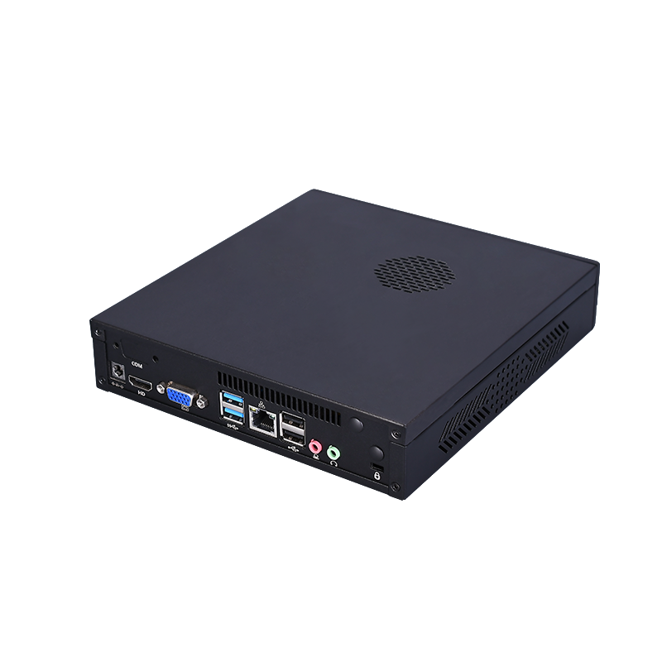
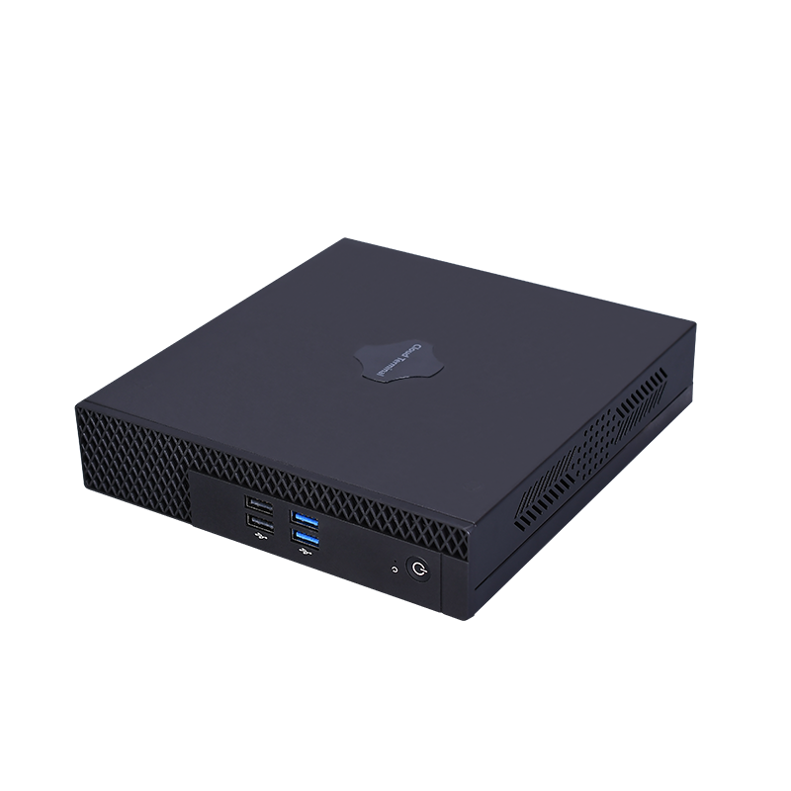
Mini PC (Office/Education)
Features:
The appearance model | T100
CPU | Supports Intel 6th, 7th/ Supports Discrete CPU
Memory Type | DDR3 1333MHz / DDR4
Memory | 2G/4G/8G
Storage | 16G/32G/64G/128G/256G
Power/power consumption | DC 12V 5A/ 60W
Graphics Chip | Intel integrated graphics card
System | Windows7/8.1/10 & Linux
WIFI | Optional
I/O Ports | DC*1，HDMI*1，VGA*1，USB2.0*2，USB3.0*4，RJ45*1，AUTO*2
Function | Support call boot, network start
Display | 800*600，1027*768，1280*720，1366*768，1440*900，1600*900，1920*1080
Cooling System | With Fan
VESA | Support
Size | 196mm*185mm*40mm
Color | Black
Material | Iron+ABS

Slide 3
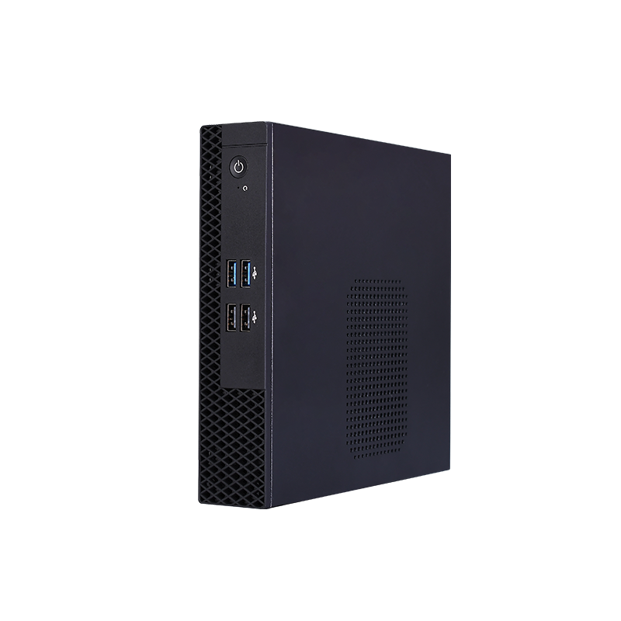
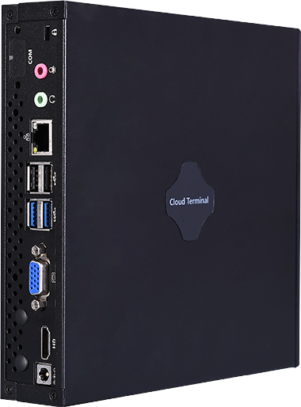
Mini PC (Office/Education)
Features:
The appearance model | T100
CPU | Supports Intel 6th, 7th
Memory Type | DDR3 1333MHz / DDR4
Memory | 2G/4G/8G
Storage | 16G/32G/64G/128G/256G
Power/power consumption | DC 12V 5A/ 60W
Graphics Chip | Intel integrated graphics card
System | Windows7/8.1/10 & Linux
WIFI | Optional
I/O Ports | DC*1，HDMI*1，VGA*1，USB2.0*2，USB3.0*4，RJ45*1，AUTO*2
Function | Support call boot, network start
Display | 800*600，1027*768，1280*720，1366*768，1440*900，1600*900，1920*1080
Cooling System | With Fan
VESA | Support
Size | 196mm*185mm*40mm
Color | Black
Material | Iron+ABS

Slide 4
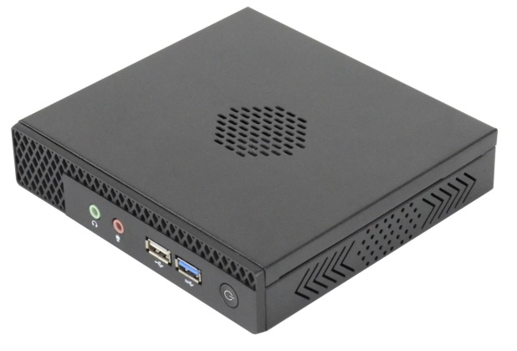
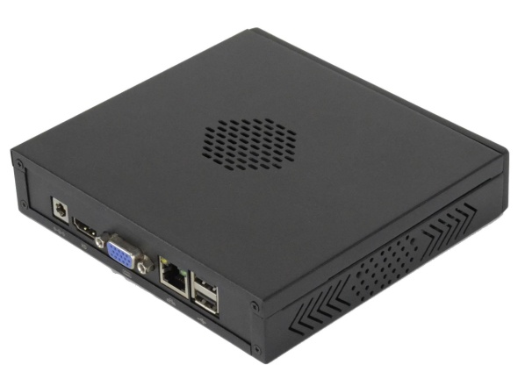
Mini PC (Office/Education)
Features:
The appearance model | T100M
CPU | Support Intel J1900/J1800/N2840
Memory Type | DDR4
Memory | Max support 8G，N5095 Max support16G
Storage | Msata (N5095 M.2)
Power/power consumption | DC 12V 3A / 36W DC 12V 5A/ 60W (alternative)
Graphics Chip | Intel integrated graphics card
System | Windows7/8.1/10 & Linux
WIFI | Optional
I/O Ports | 1*DC2.5, 1*HDMI, 1*DP, 1*VGA, 4*USB3.0, 2*USB2.0, 1*Type-C, 1*RJ45, 1*SPK, 1*MIC
Function | Support call boot, network start
Display | 800*600，1027*768，1280*720，1366*768，1440*900，1600*900，1920*1080
Cooling System | With Fan
VESA | Support
Size | 148*136*30mm
Color | Black/Silver
Material | Plastic/Aluminium alloy

Slide 5
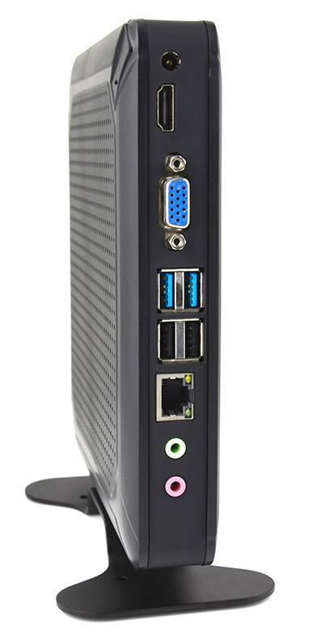
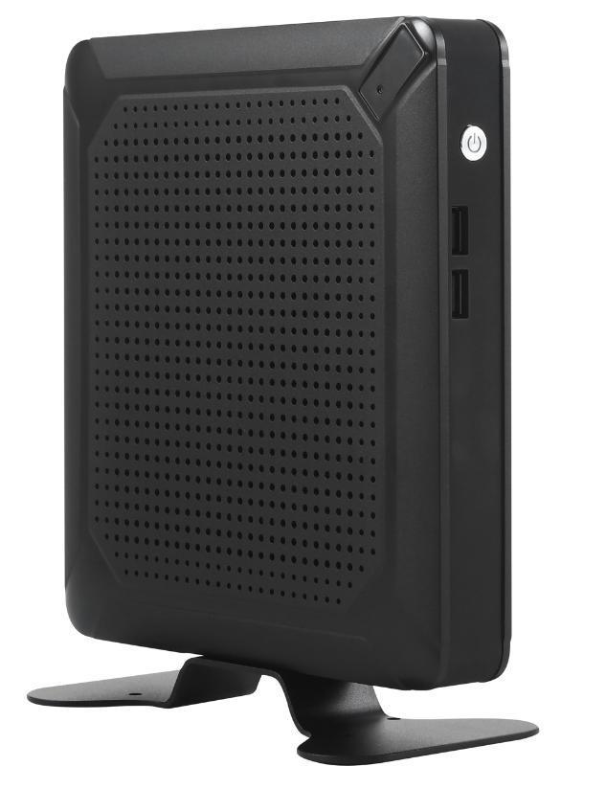
Mini PC (Office/Education)
Features:
The appearance model | SC
CPU | Support Intel Celeron/pentium/J1900/J1800/3867U/Core i3/i5/i7
Memory Type | DDR3L/LPDDR4
Memory | 4GB/8GB/16GB
Storage | 32GB/64GB/128GB/256GB
Power/power consumption | DC 12V 3A / 36W DC 12V 5A/ 60W (alternative)
Graphics Chip | Intel integrated graphics card
System | Windows7/8.1/10 & Linux
WIFI | Optional
I/O Ports | DC*1,HDMI*1, VGA*1,USB3.0*2, USB2.0*4,RJ45*1,AUDIO or DC*1,HDMI*1, VGA*1,USB3.0*4, USB2.0*2,RJ45*1,AUDIO
Function | Support call boot, network start
Display | 800*600，1027*768，1280*720，1366*768，1440*900，1600*900，1920*1080
Cooling System | Fan cooling
VESA | Support
Size | 172MM*186MM*35MM
Color | Black
Material | Plastic

Slide 6
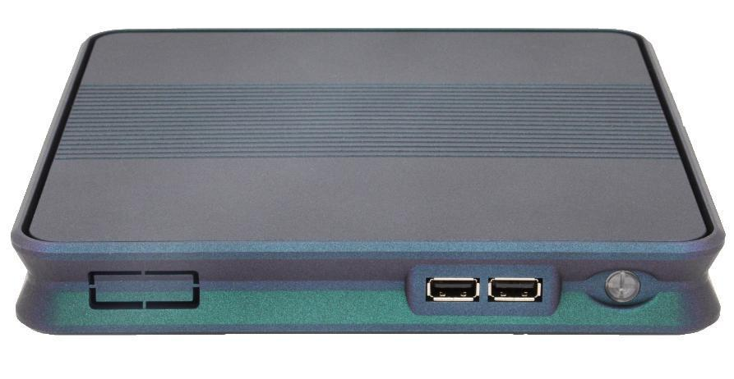
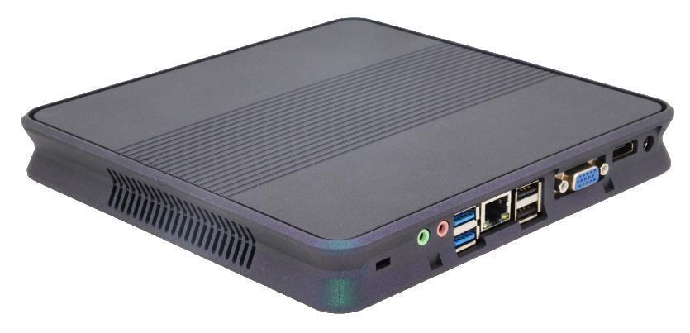
Mini PC (Office/Education)
Features:
The appearance model | SA
CPU | Support Intel Celeron/pentium/J1900/J1800/3867U/Core i3/i5/i7
Memory Type | DDR3L/LPDDR4
Memory | 4GB/8GB/16GB
Storage | 32GB/64GB/128GB/256GB Support for HDDS extensions
Power/power consumption | DC 12V 3A / 36W DC 12V 5A/ 60W (alternative)
Graphics Chip | Intel integrated graphics card
System | Windows7/8.1/10 & Linux
WIFI | Optional
I/O Ports | DC*1, HDMI*1, VGA*1,USB3.0*2, USB2.0*4,RJ45*1,AUDIO, RS232*1（Optional） or DC*1, HDMI*1, VGA*1,USB3.0*4, USB2.0*2,RJ45*1,AUDIO, RS232*1（Optional）
Function | Support call boot, network start
Display | 800*600，1027*768，1280*720，1366*768，1440*900，1600*900，1920*1080
Cooling System | Fan cooling
VESA | Support
Size | 200mm*200mm*37mm
Color | Pearl black/silver/chameleon
Material | Plastic

Slide 7
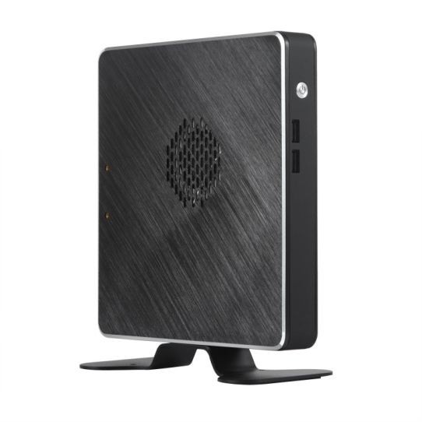
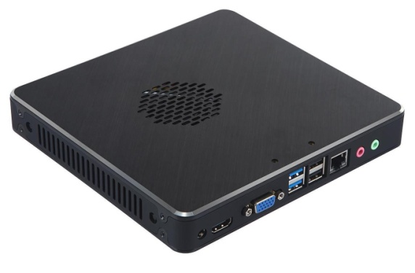
Mini PC (Office/Education)
Features:
The appearance model | SD
CPU | Support Intel Celeron/pentium/J1900/J1800/3867U/Core i3/i5/i7
Memory Type | DDR3L/LPDDR4
Memory | 4GB/8GB/16GB
Storage | 32GB/64GB/128GB/256GB
Power/power consumption | DC 12V 3A / 36W DC 12V 5A/ 60W (alternative)
Graphics Chip | Intel integrated graphics card
System | Windows7/8.1/10 & Linux
WIFI | Optional
I/O Ports | DC*1，HDMI*1, VGA*1,USB3.0*2, USB2.0*4,RJ45*1,AUDIO or DC*1，HDMI*1, VGA*1,USB3.0*4, USB2.0*2,RJ45*1,AUDIO
Function | Support call boot, network start
Display | 800*600，1027*768，1280*720，1366*768，1440*900，1600*900，1920*1080
Cooling System | Fan cooling
VESA | Support
Size | 176MM*186MM*28MM
Color | Black/Silver
Material | Aluminium alloy/Plastic

Slide 8
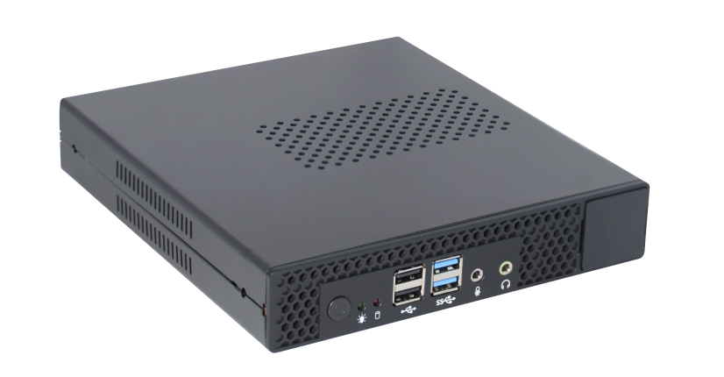
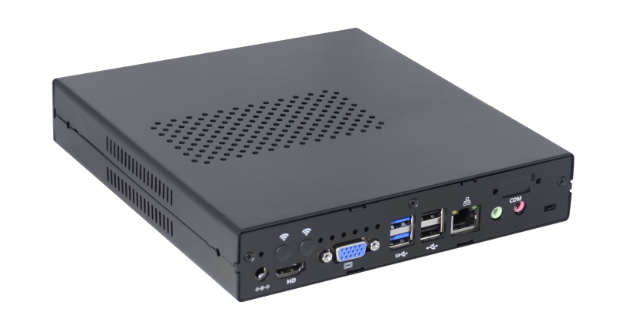
Mini PC (Office/Education)
Features:
The appearance model | TD
CPU | Support Intel Celeron/pentium/J1900/J1800/3867U/Core i3/i5/i7
Memory Type | DDR3L/LPDDR4
Memory | 4GB/8GB/16GB
Storage | 32GB/64GB/128GB/256GB
Power/power consumption | DC 12V 3A / 36W DC 12V 5A/ 60W (alternative)
Graphics Chip | Intel integrated graphics card
System | Windows7/8.1/10 & Linux
WIFI | Optional
I/O Ports | DC*1, HDMI*1, VGA*1,USB3.0*2, USB2.0*4,RJ45*1,AUDIO, RS232*1（Optional） or DC*1, HDMI*1, VGA*1,USB3.0*4, USB2.0*2,RJ45*1,AUDIO, RS232*1（Optional）
Function | Support call boot, network start
Display | 800*600，1027*768，1280*720，1366*768，1440*900，1600*900，1920*1080
Cooling System | Fan cooling
VESA | Support
Size | 196MM*182MM*36MM
Color | Black
Material | Galvanized iron/Plastic

Slide 9
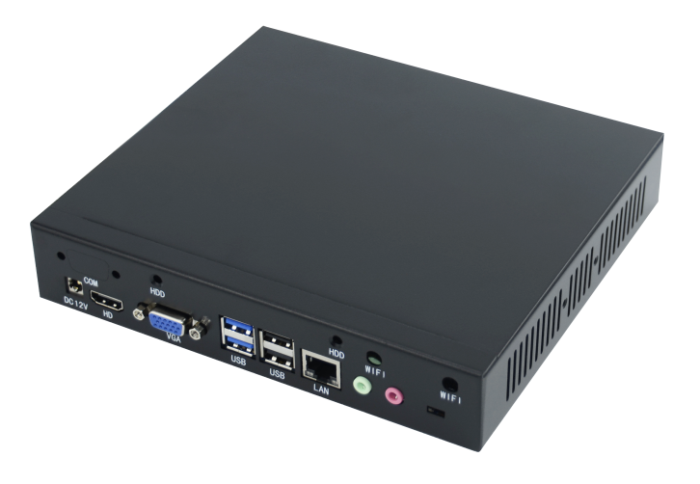
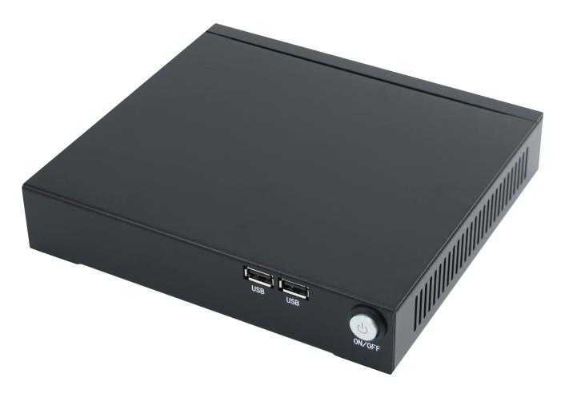
Mini PC (Office/Education)
Features:
The appearance model | TA
CPU | Support Intel Celeron/pentium/J1900/J1800/3867U/Core i3/i5/i7
Memory Type | DDR3L/LPDDR4
Memory | 4GB/8GB/16GB
Storage | 32GB/64GB/128GB/256GB Support for HDDS extensions
Power/power consumption | DC 12V 3A / 36W DC 12V 5A/ 60W (alternative)
Graphics Chip | Intel integrated graphics card
System | Windows7/8.1/10 & Linux
WIFI | Optional
I/O Ports | DC*1, HDMI*1, VGA*1,USB3.0*2, USB2.0*4,RJ45*1,AUDIO, RS232*1（Optional） or DC*1, HDMI*1, VGA*1,USB3.0*4, USB2.0*2,RJ45*1,AUDIO, RS232*1（Optional）
Function | Support call boot, network start
Display | 800*600，1027*768，1280*720，1366*768，1440*900，1600*900，1920*1080
Cooling System | Fan cooling
VESA | Support
Size | 193MM*175MM*33MM
Color | Black
Material | Galvanized iron

Slide 10
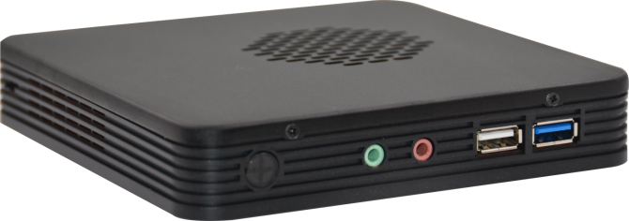
Mini PC (Office/Education)
Features:
The appearance model | X3
CPU | Support Intel Pentium/J1900/J1800/N2840
Memory Type | DDR3L
Memory | 2G/4G/8G
Storage | 16G/32G/64G/128G/256G
Power/power consumption | DC 12V 3A / 36W DC 12V 5A/ 60W (alternative)
Graphics Chip | Intel integrated graphics card
System | Windows7/8.1/10 & Linux
WIFI | Optional
I/O Ports | DC*1，HDMI*1，VGA*1，RJ45*1，USB3.0*1，USB2.0*3，AUDIO
Function | Support call boot, network start
Display | 800*600，1027*768，1280*720，1366*768，1440*900，1600*900，1920*1080
Cooling System | With Fan
VESA | Support
Size | 140MM*140MM*29MM
Color | Black/Silver
Material | Plastic/Aluminium alloy

Slide 11
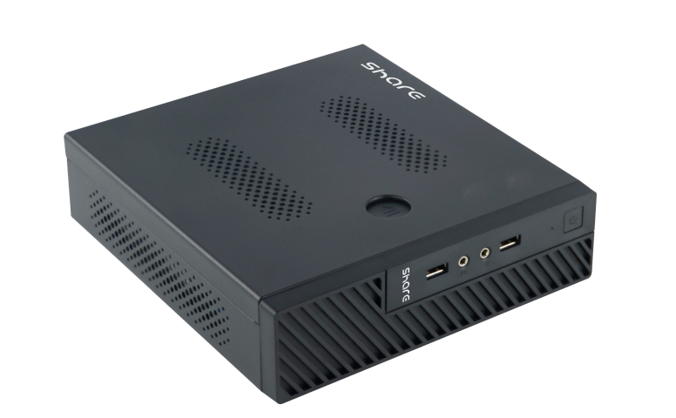
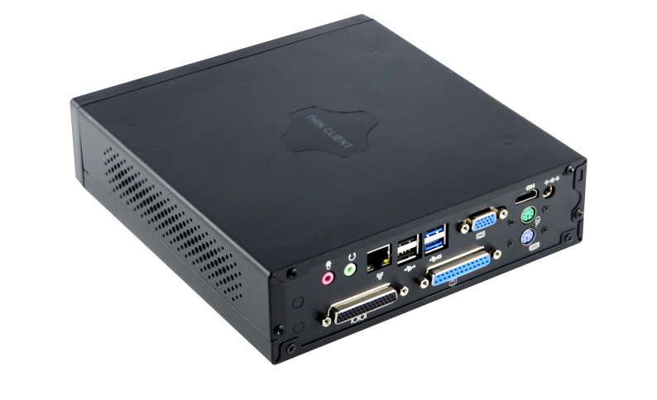
Mini PC (Office/Education)
Features:
The appearance model | M100
CPU | Support Intel 6, 7
Memory Type | DDR4L
Memory | 2G/4G/8G/16G
Storage | 16G/32G/64G/128G/256G
Power/power consumption | DC 12V 5A/ 60W
Graphics Chip | Intel integrated graphics card
System | Windows7/8.1/10 & Linux
WIFI | Optional
I/O Ports | DC*1，HDMI*1，VGA*1，USB2.0*4，USB3.0*2，RJ45*1，AUTO*2，PS2*2，LPT*1，COM*4（Turn a four）
Function | Support call boot, network start
Display | 800*600，1027*768，1280*720，1366*768，1440*900，1600*900，1920*1080
Cooling System | With Fan
VESA | Support
Size | 200mm*200mm*55mm
Color | Black
Material | Iron

Slide 12
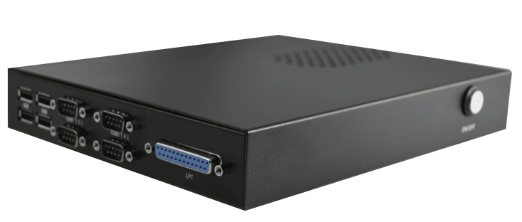
Mini PC (Office/Education)
Features:
The appearance model | TB
CPU | Support Intel Celeron/pentium/J1900/J1800/3867U/Core i3/i5/i7
Memory Type | DDR3L/LPDDR4
Memory | 4GB/8GB/16GB
Storage | 32GB/64GB/128GB/256GB Support for HDDS extensions
Power/power consumption | DC 12V 3A / 36W DC 12V 5A/ 60W (alternative)
Graphics Chip | Intel integrated graphics card
System | Windows7/8.1/10 & Linux
WIFI | Optional
I/O Ports | DC*1,HDMI*1,VGA*1,USB2.0*6,USB*3.0*2,RJ45*1,PS2*2,RS232*4,LPT*1,AUDIO orDC*1,HDMI*1,VGA*1,USB2.0*4,USB*3.0*4,RJ45*1,PS2*2,RS232*4,LPT*1,AUDIO
Function | Support call boot, network start
Display | 800*600，1027*768，1280*720，1366*768，1440*900，1600*900，1920*1080
Cooling System | Fan cooling
VESA | Support
Size | 193MM*175MM*33MM
Color | Black
Material | Galvanized iron

Slide 13
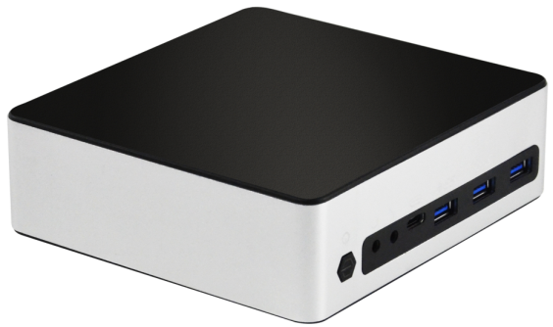
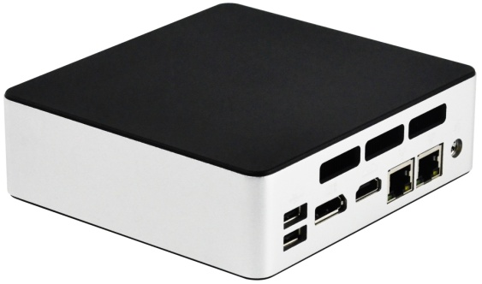
Mini PC (NUC)
Features:
The appearance model | MX-12
CPU | Support Intel i5-1245U/i7-1255U/i7-1260U
Memory Type | 2*DDR5
Memory | 4G/8G/16G/64G
Storage | 2*M.2
Power/power consumption | DC 19V 6.32A/ 120W
Graphics Chip | Intel integrated graphics card
System | Windows10/11 & Linux
WIFI | Optional
I/O Ports | 1*DC, 1*HDMI, 1*DP, 3*USB3.0, 2*USB2.0, 1*Type-C, 2*RJ45, 1*SPK, 1*MIC
Function | Support call boot, network start
Display | 800*600，1027*768，1280*720，1366*768，1440*900，1600*900，1920*1080
Cooling System | With Fan
VESA | Support
Size | 135*126*45mm
Color | Black/Silver
Material | Metal + Plastic

Slide 14
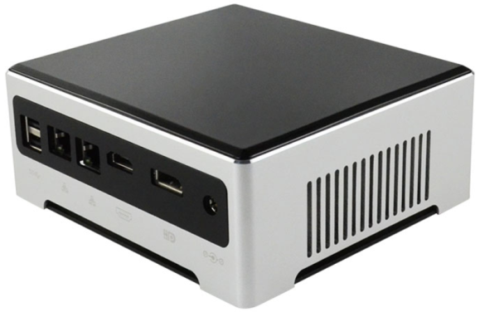
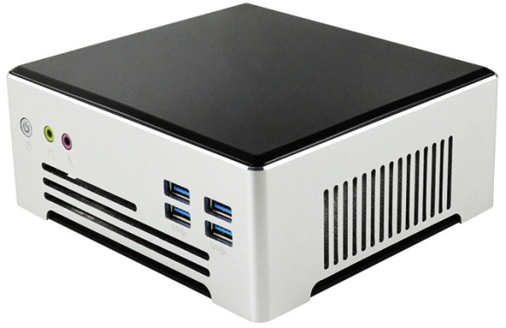
Mini PC (NUC)
Features:
The appearance model | MX-PRO
CPU | Support Intel i3 1115G4/ i5 1135G7/i7 1165G7
Memory Type | 2*DDR4
Memory | 4G/8G/16G/64G
Storage | 1*M.2 SATA+1*M.2 NVMe
Power/power consumption | DC 12V 7A/ 84W
Graphics Chip | Intel integrated graphics card
System | Windows10/11 & Linux
WIFI | Optional
I/O Ports | 1*DC, 1*HDMI, 1*DP, 4*USB3.0, 2*USB2.0, 2*RJ45, 1*SPK, 1*MIC
Function | Support call boot, network start
Display | 800*600，1027*768，1280*720，1366*768，1440*900，1600*900，1920*1080
Cooling System | With Fan
VESA | Support
Size | 150*140*60mm
Color | Black/Silver
Material | Metal + Plastic

Slide 15
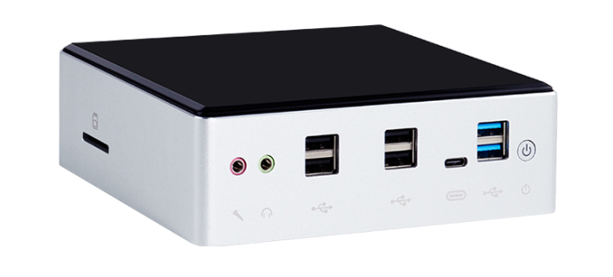
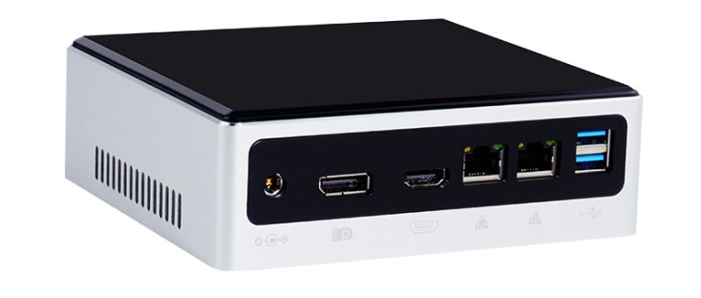
Mini PC (NUC)
Features:
The appearance model | MX
CPU | Support Intel i3 10110U/ i5 10210U /i7 10810U
Memory Type | 2*DDR4
Memory | 4G/8G/16G/64G
Storage | 1*M.2
Power/power consumption | DC 12V 7A/ 84W
Graphics Chip | Intel integrated graphics card
System | Windows10/11 & Linux
WIFI | Optional
I/O Ports | 1*DC, 1*HDMI, 1*DP, 4*USB3.0, 4*USB2.0, 1*Type-C, 2*RJ45, 1*SPK, 1*MIC
Function | Support call boot, network start
Display | 800*600，1027*768，1280*720，1366*768，1440*900，1600*900，1920*1080
Cooling System | With Fan
VESA | Support
Size | 150mm*137mm*50mm
Color | Black/Silver
Material | Metal + Plastic

Slide 16
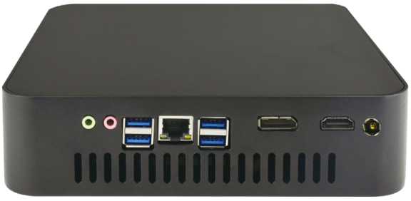
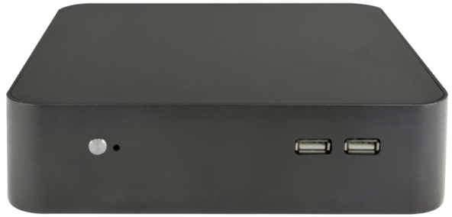
Mini PC (NUC)
Features:
The appearance model | L10
CPU | Support intel 10gen/11gen/12gen
Memory Type | 2*DDR4
Memory | 4G/8G/16G/64G/128G
Storage | M.2(Support sata and NVME); Support 2.5 sata expand
Power/power consumption | DC 19V 6.32A/ 120W
Graphics Chip | Intel integrated graphics card
System | Windows10/11 & Linux
WIFI | Optional
I/O Ports | 1*DC2.5, 1*HDMI, 1*DP, 4*USB3.0, 2*USB2.0, 1*RJ45, 1*SPK, 1*MIC
Function | Support call boot, network start
Display | 800*600，1027*768，1280*720，1366*768，1440*900，1600*900，1920*1080
Cooling System | With Fan
VESA | Support
Size | 196*196*50mm
Color | Black
Material | Aluminium alloy

Slide 17
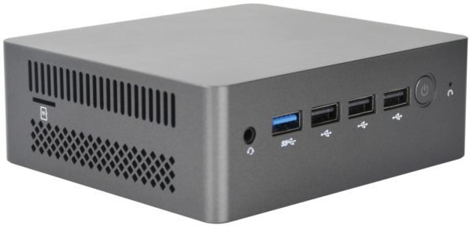
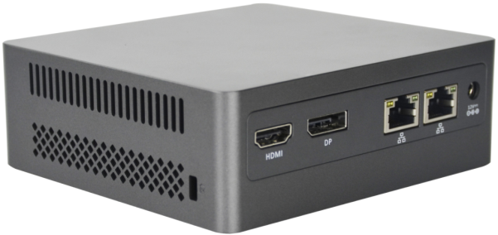
Mini PC (NUC)
Features:
The appearance model | N100
CPU | Support intel N95/N100/N300/N305
Memory Type | 2*DDR4
Memory | 4G/8G/16G/64G/128G
Storage | M.2(Support sata and NVME); Support 2.5 sata expand
Power/power consumption | DC 19V 6.32A/ 120W
Graphics Chip | Intel integrated graphics card
System | Windows10/11 & Linux
WIFI | Optional
I/O Ports | 1*DC2.5, 1*HDMI, 1*DP, 4*USB3.0, 2*USB2.0, 1*RJ45, 1*SPK, 1*MIC
Function | Support call boot, network start
Display | 800*600，1027*768，1280*720，1366*768，1440*900，1600*900，1920*1080
Cooling System | With Fan
VESA | Support
Size | 150*140*60mm
Color | Black
Material | Aluminium alloy

Slide 18
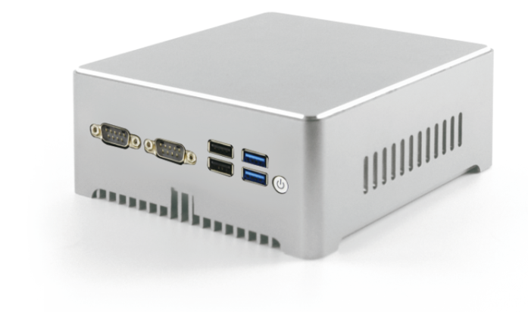
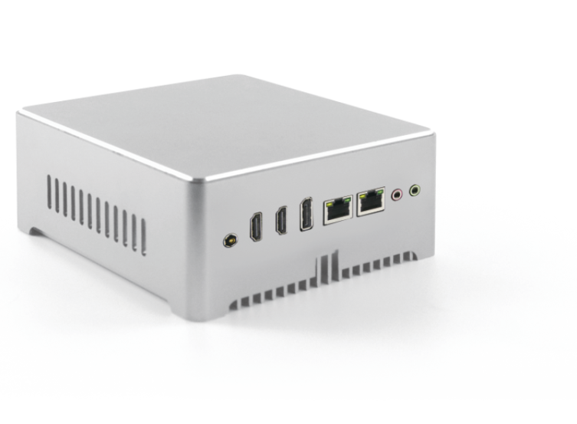
Mini PC (NUC)
Features:
The appearance model | MD-PRO
CPU | Support intel J4105/J4125/J6412
Memory Type | 1*DDR4
Memory | 4G/8G/16G
Storage | 1*Msata+1*M.2 2280 NVME+1*2.5inch HDD
Power/power consumption | DC 12V 5A/ 60W
Graphics Chip | Intel integrated graphics card
System | Windows10/11 & Linux
WIFI | Optional
I/O Ports | 1*DC2.5，2*HDMI，1*DP，2*USB3.0，2*USB2.0，2*RJ45，1*SPK，1*MIC，2*RS232
Function | Support call boot, network start
Display | 800*600，1027*768，1280*720，1366*768，1440*900，1600*900，1920*1080
Cooling System | Fanless
VESA | Support
Size | 136*127*40mm
Color | Black/Silver
Material | Aluminium alloy

Slide 19
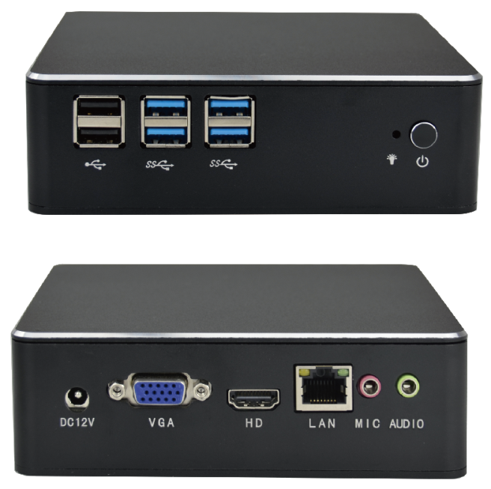
Mini PC (NUC)
Features:
The appearance model | MD
CPU | Support Intel Core i3/i5/i7
Memory Type | DDR4
Memory | 4G/8G/16GB
Storage | 16G/32G/64G/128G/256G
Power/power consumption | DC 12V 5A / 36W DC 12V 5A/ 60W (alternative)
Graphics Chip | Intel integrated graphics card
System | Windows7/8.1/10 & Linux
WIFI | Optional
I/O Ports | DC*1，HDMI*1，DP*1，RJ45*2，USB3.0*4，USB2.0*4，Type-c*1，AUDIO SD*1
Function | Support call boot, network start
Display | 800*600，1027*768，1280*720，1366*768，1440*900，1600*900，1920*1080
Cooling System | Fan cooling
VESA | Support
Size | 135MM*150MM*50MM
Color | Black
Material | Aluminium alloy/Plastic

Slide 20
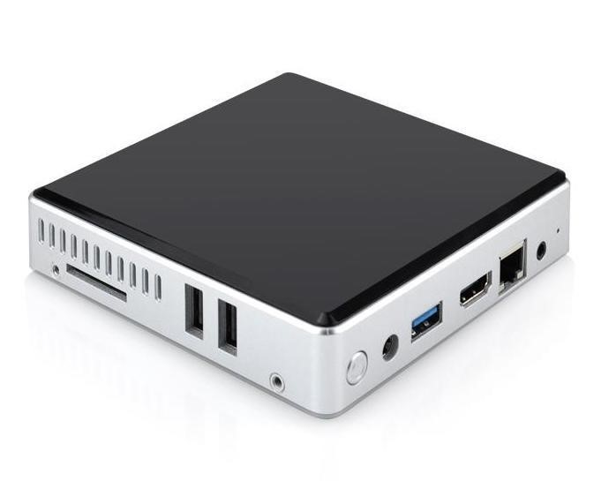
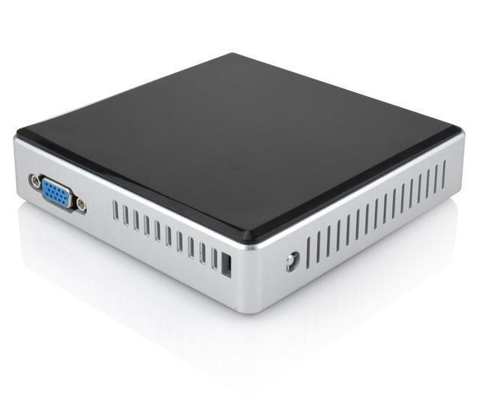
Mini PC (NUC)
Features:
The appearance model | X2
CPU | Support Intel Z8350/Pentium N3350/N4000/N4100
Memory Type | Onboard
Memory | 2G/4G/8G
Storage | EMMC 16G/32G/64G/128G
Power/power consumption | DC 12V 3A / 36W DC 12V 5A/ 60W (alternative)
Graphics Chip | Intel integrated graphics card
System | Windows7/8.1/10 & Linux
WIFI | Optional
I/O Ports | DC*1，USB3.0*1，USB2.0*2，RJ45*1，VGA*1，HDMI*1，SD*1
Function | Support call boot, network start
Display | 800*600，1027*768，1280*720，1366*768，1440*900，1600*900，1920*1080
Cooling System | Fanless No Sound
VESA | Support
Size | 199MM*199MM*27MM
Color | Black/Silver
Material | Plastic

Slide 21
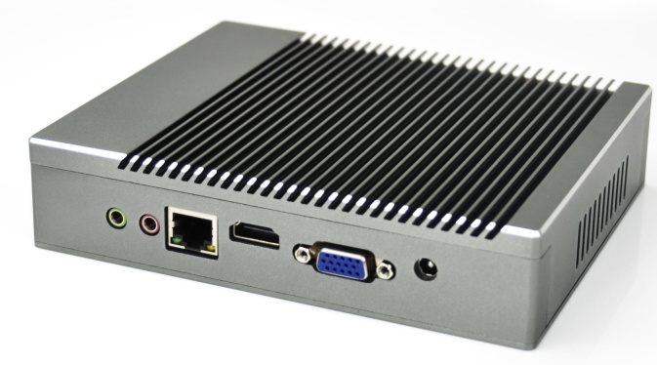
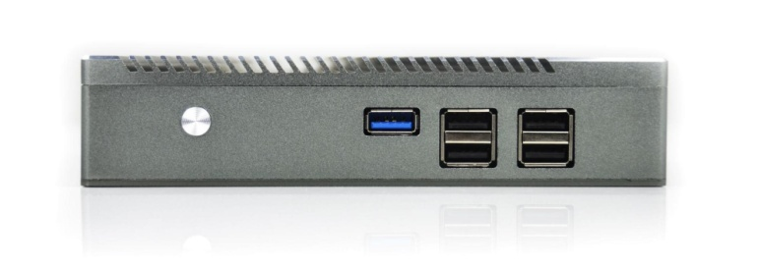
Mini PC (Industrial class)
Features:
The appearance model | MU
CPU | Support Intel pentium/J1900/J1800/N2940/N3540
Memory Type | DDR3L
Memory | 2G/4G/8G
Storage | 16G/32G/64G/128G/256G
Power/power consumption | DC 12V 3A / 36W DC 12V 5A/ 60W (alternative)
Graphics Chip | Intel integrated graphics card
System | Windows7/8.1/10 & Linux
WIFI | Optional
I/O Ports | DC*1，HDMI*1，VGA*1，RJ45*1，USB3.0*1，USB2.0*4，AUDIO
Function | Support call boot, network start
Display | 800*600，1027*768，1280*720，1366*768，1440*900，1600*900，1920*1080
Cooling System | Fanless No Sound
VESA | Support
Size | 160MM*129MM*36MM
Color | Silver
Material | Aluminium alloy

Slide 22
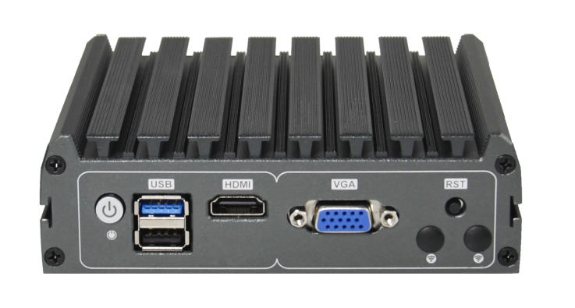
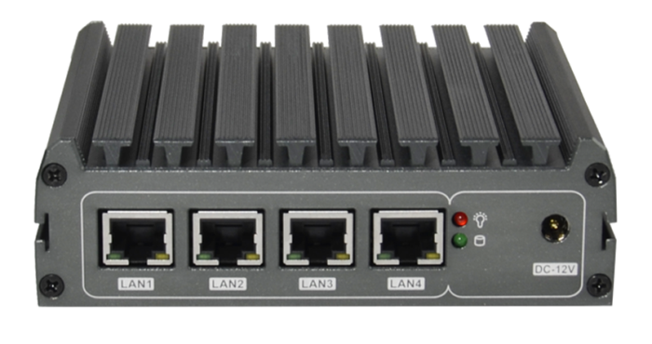
Mini PC (Industrial class)
Features:
The appearance model | MN4
CPU | Support Intel Celeron J1900/N2930/N2940
Memory Type | DDR3L
Memory | 4GB/8GB
Storage | 32GB/64GB/128GB/256GB
Power/power consumption | DC 12V 3A / 36W DC 12V 5A/ 60W (alternative)
Graphics Chip | Intel integrated graphics card
System | Windows7/8.1/10 & Linux
WIFI | Optional
I/O Ports | DC*1，RJ45*4，VGA*1，USB*2
Function | Support call boot, network start
Display | 800*600，1027*768，1280*720，1366*768，1440*900，1600*900，1920*1080
Cooling System | Fanless
VESA | Support
Size | 133MM*126MM*40MM
Color | Black
Material | Aluminium alloy

Slide 23
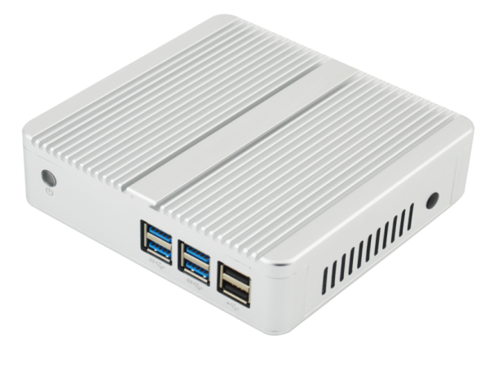
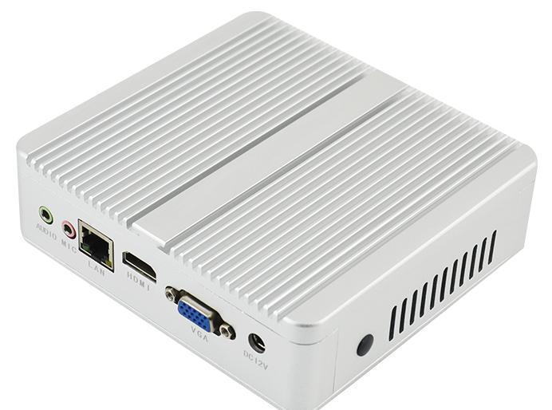
Mini PC (Industrial class)
Features:
The appearance model | MN
CPU | Support Intel Celeron/pentium/J1900 Core i3/i5
Memory Type | DDR3L/LPDDR4
Memory | 4GB/8GB/16GB
Storage | 32GB/64GB/128GB/256GB Support for HDDS extensions
Power/power consumption | DC 12V 3A / 36W DC 12V 5A/ 60W (alternative)
Graphics Chip | Intel integrated graphics card
System | Windows7/8.1/10 & Linux
WIFI | Optional
I/O Ports | DC*1,HDMI*1,VGA*1,USB3.0*1,USB2.0*4,RJ45*1,AUDIO,RS232*1(Optional) orDC*1,HDMI*1,VGA*1,USB3.0*4,USB2.0*2,RJ45*1,AUDIO,RS232*1(Optional)
Function | Support call boot, network start
Display | 800*600，1027*768，1280*720，1366*768，1440*900，1600*900，1920*1080
Cooling System | Fanless
VESA | Support
Size | 127MM*134MM*40MM
Color | Black/Silver
Material | Aluminium alloy

Slide 24
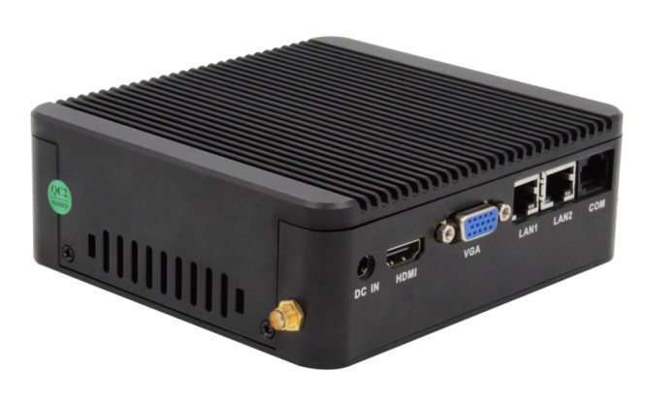
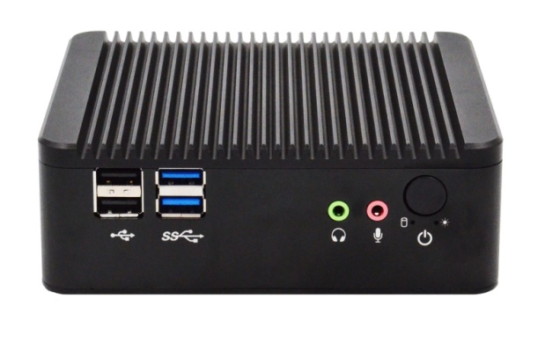
Mini PC (Industrial class)
Features:
The appearance model | MB
CPU | Support Intel Celeron/J1900
Memory Type | DDR3L
Memory | 4GB/8GB
Storage | 32GB/64GB/128GB/256GB Support for HDDS extensions
Power/power consumption | DC 12V 3A / 36W DC 12V 5A/ 60W (alternative)
Graphics Chip | Intel integrated graphics card
System | Windows7/8.1/10 & Linux
WIFI | Optional
I/O Ports | DC*1，HDMI*1, VGA*1,RJ45*2，RS232*1，USB2.0*2，USB3.0*2，AUDIO
Function | Support call boot, network start
Display | 800*600，1027*768，1280*720，1366*768，1440*900，1600*900，1920*1080
Cooling System | Fanless
VESA | Support
Size | 134MM*124MM*46MM
Color | Black
Material | Aluminium alloy

Slide 25
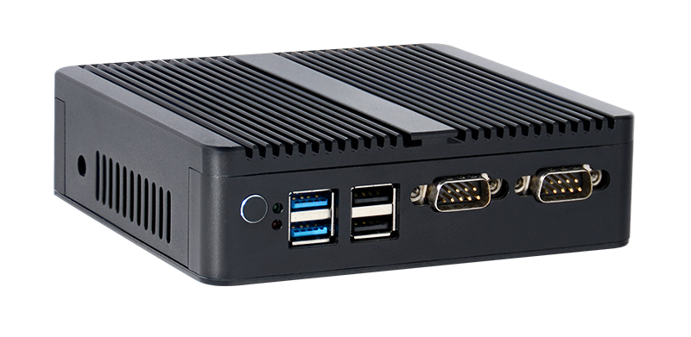
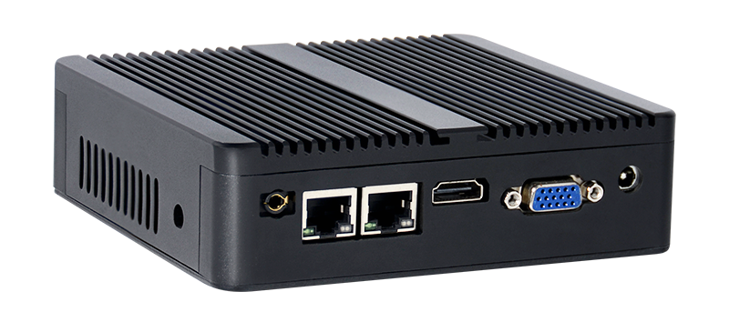
Mini PC (Industrial class)
Features:
The appearance model | MC
CPU | Support Intel Celeron/J1900
Memory Type | DDR3L
Memory | 4GB/8GB
Storage | 32GB/64GB/128GB/256GB Support for HDDS extensions
Power/power consumption | DC 12V 3A / 36W DC 12V 5A/ 60W (alternative)
Graphics Chip | Intel integrated graphics card
System | Windows7/8.1/10 & Linux
WIFI | Optional
I/O Ports | DC*1，HDMI*1, VGA*1,RJ45*2，RS232*2，USB2.0*2，USB3.0*2，AUDIO
Function | Support call boot, network start
Display | 800*600，1027*768，1280*720，1366*768，1440*900，1600*900，1920*1080
Cooling System | Fanless
VESA | Support
Size | 134MM*124MM*46MM
Color | Black
Material | Aluminium alloy

Slide 26
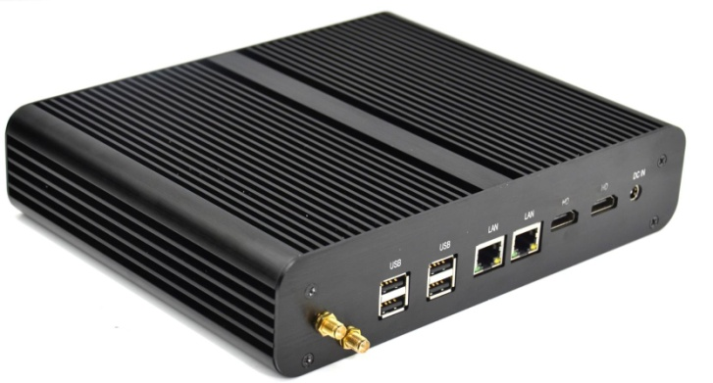
Mini PC (Industrial class)
Features:
The appearance model | PH
CPU | Support Intel Celeron/J1900/i3 i5 i7
Memory Type | DDR3
Memory | 4GB/8GB/16G
Storage | 32GB/64GB/128GB/256GB Support for HDDS extensions
Power/power consumption | DC 12V 3A / 36W DC 12V 5A/ 60W (alternative)
Graphics Chip | Intel integrated graphics card
System | Windows7/8.1/10 & Linux
WIFI | Optional
I/O Ports | DC*1, HDMI*2, RJ45*2, USB2.0*4, USB3.0*4, SD*1, Audio frequency fiber, AUDIO
Function | Support call boot, network start
Display | 800*600，1027*768，1280*720，1366*768，1440*900，1600*900，1920*1080
Cooling System | Fanless
VESA | Support
Size | 213MM*176MM*51MM
Color | Black
Material | Aluminium alloy

Slide 27
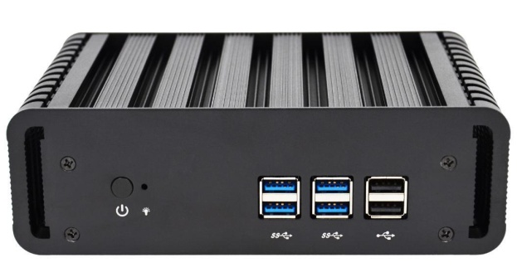
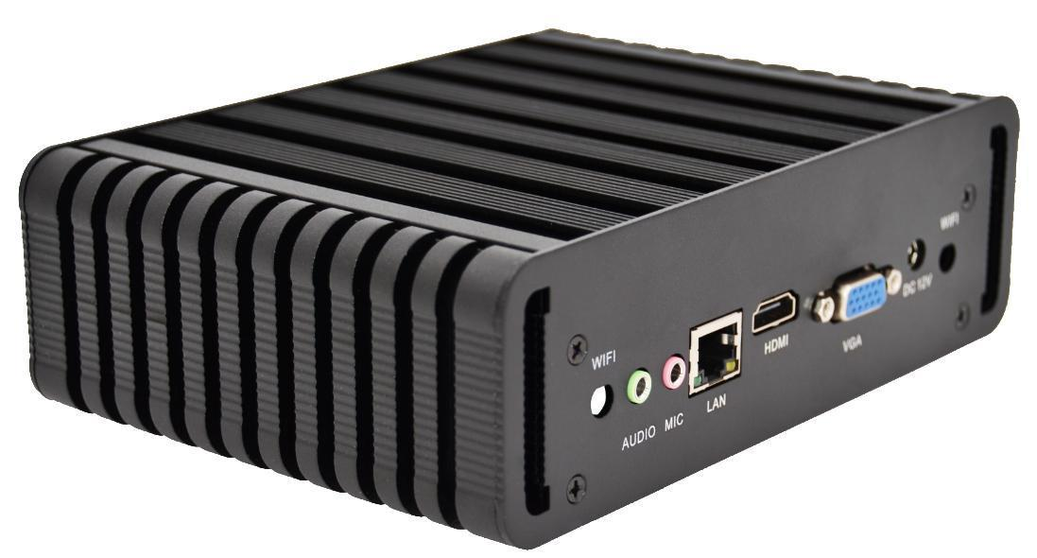
Mini PC (Industrial class)
Features:
The appearance model | MH
CPU | Support Intel Core i3/i5/i7
Memory Type | DDR3L/LPDDR4
Memory | 4GB/8GB/16GB
Storage | 32GB/64GB/128GB/256GB Support for HDDS extensions
Power/power consumption | DC 12V 3A / 36W DC 12V 5A/ 60W (alternative)
Graphics Chip | Intel integrated graphics card
System | Windows7/8.1/10 & Linux
WIFI | Optional
I/O Ports | DC*1, HDMI*1, VGA*1,USB3.0*4, USB2.0*2,RJ45*1,Audio,RS232*2(Optional)
Function | Support call boot, network start
Display | 800*600，1027*768，1280*720，1366*768，1440*900，1600*900，1920*1080
Cooling System | Fanless
VESA | Support
Size | 127MM*178MM*56MM
Color | Black/Silver
Material | Aluminium alloy

Slide 28
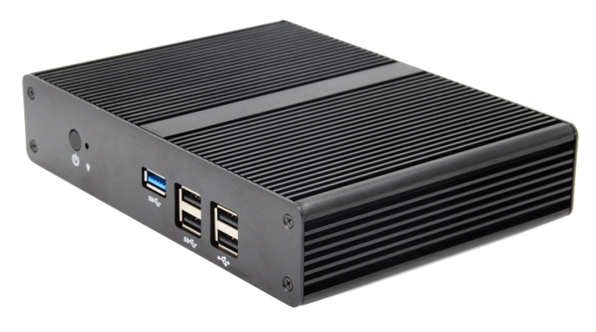
Mini PC (Industrial class)
Features:
The appearance model | ML
CPU | Support Intel Celeron/pentium/J1900 Core i3/i5
Memory Type | DDR3
Memory | 4GB/8GB
Storage | 32GB/64GB/128GB/256GB Support for HDDS extensions
Power/power consumption | DC 12V 3A / 36W DC 12V 5A/ 60W (alternative)
Graphics Chip | Intel integrated graphics card
System | Windows7/8.1/10 & Linux
WIFI | Optional
I/O Ports | DC*1,HDMI*1,VGA*1,USB3.0*1,USB2.0*4,RJ45*1,Audio,RS232*1(Optional) orDC*1,HDMI*1,VGA*1,USB3.0*4,USB2.0*2,RJ45*1,Audio,RS232*1(Optional)
Function | Support call boot, network start
Display | 800*600，1027*768，1280*720，1366*768，1440*900，1600*900，1920*1080
Cooling System | Fanless
VESA | Support
Size | 175MM*126MM*37MM
Color | Black/Silver
Material | Aluminium alloy

Slide 29
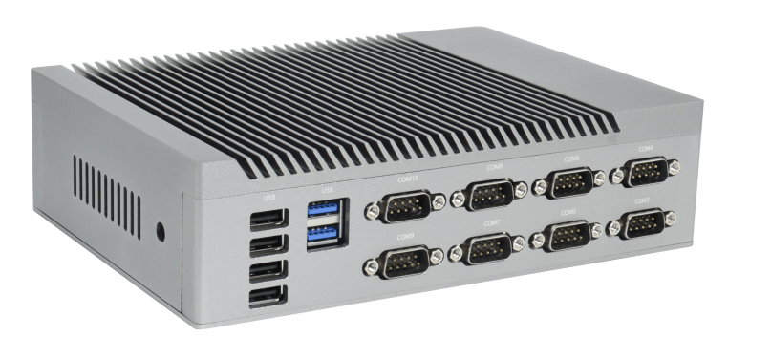
Mini PC (Industrial class)
Features:
The appearance model | MG
CPU | Support Intel J1900
Memory Type | DDR3L
Memory | 2G/4G/8G
Storage | 16G/32G/64G/128G/256G
Power/power consumption | DC 12V 5A/ 60W
Graphics Chip | Intel integrated graphics card
System | Windows7/8.1/10 & Linux
WIFI | Optional
I/O Ports | DC*1，ATXIN1_12V*1，PWR_SW1*1, PWR_SW2*1，HDMI*1，VGA*1，RJ45*2，USB3.0*1，USB2.0*9，AUDIO，RS232*10，LPT*1
Function | Support call boot, network start
Display | 800*600，1027*768，1280*720，1366*768，1440*900，1600*900，1920*1080
Cooling System | The shell heat dissipation
VESA | Support
Size | 200MM*145MM*55MM
Color | Silver
Material | Aluminium alloy

Slide 30
OPS
Features:
The appearance model | OPS-1
CPU | Support Intel 6, 7
Memory Type | DDR4L
Memory | 2G/4G/8G/16G
Storage | 16G/32G/64G/128G/256G
Power/power consumption | DC 12V 3A / 36W DC 12V 5A/ 60W (alternative)
Graphics Chip | Intel integrated graphics card
System | Windows7/8.1/10 & Linux
WIFI | Optional
I/O Ports | DC*1，HDMI*1，VGA*1，RJ45*1，USB2.0*4，OPS，AUDIO
Function | Support call boot, network start
Display | 800*600，1027*768，1280*720，1366*768，1440*900，1600*900，1920*1080
Cooling System | With Fan
VESA | Support
Color | Black
Size | 180mm*120mm*30mm
Material | Aluminium alloy

Slide 31
OPS
Features:
The appearance model | OPS-2
CPU | Support Intel 6, 7
Memory Type | DDR4L
Memory | 2G/4G/8G/16G
Storage | 16G/32G/64G/128G/256G
Power/power consumption | DC 12V 3A / 36W DC 12V 5A/ 60W (alternative)
Graphics Chip | Intel integrated graphics card
System | Windows7/8.1/10 & Linux
WIFI | Optional
I/O Ports | DC*1，HDMI*1，VGA*1，RJ45*1，USB2.0*4，OPS，AUDIO
Function | Support call boot, network start
Display | 800*600，1027*768，1280*720，1366*768，1440*900，1600*900，1920*1080
Cooling System | With Fan
VESA | Support
Color | Black
Pin | Standard 80 pin
Size | 180mm*119mm*30mm
Material | Aluminium alloy

Slide 32
OPS
Features:
The appearance model | OPS-H
CPU | Support Intel 6, 7
Memory Type | DDR4L
Memory | 2G/4G/8G/16G
Storage | 16G/32G/64G/128G/256G
Power/power consumption | DC 12V 3A / 36W DC 12V 5A/ 60W (alternative)
Graphics Chip | Intel integrated graphics card
System | Windows7/8.1/10 & Linux
WIFI | Optional
I/O Ports | DC*1，HDMI*1，DP*1，USB3.0*3，USB2.0*3，RS232*1，RESET*1，POWER*1，VGA*1(Optional)
Function | Support call boot, network start
Display | 800*600，1027*768，1280*720，1366*768，1440*900，1600*900，1920*1080
Cooling System | With Fan
VESA | Support
Size | 180mm*195mm*42mm
Color | Black
Material | Aluminium alloy

Slide 33
OPS
Features:
The appearance model | OPS-X5000-1
CPU | Support Intel Core i3-10100/i5-10400/i5-10500/i7-10700 i3-11100 i5-11400/i5-11500/i7-11700 Other 10th/11th generation Core processors
Memory Type | DDR4L
Memory | 2G/4G/8G/16G
Storage | 16G/32G/64G/128G/256G
Power/power consumption | DC 12V 3A / 36W DC 12V 5A/ 60W (alternative)
Graphics Chip | Intel integrated graphics card
System | Windows7/8.1/10 & Linux
WIFI | Optional
I/O Ports | DC*1，HDMI*1，DP*1，USB3.0*3，USB2.0*3，RS232*1，RESET*1，POWER*1，VGA*1(Optional)
Function | Support call boot, network start
Display | 800*600，1027*768，1280*720，1366*768，1440*900，1600*900，1920*1080
Cooling System | With Fan
VESA | Support
Size | 180mm*195mm*42mm
Color | Black
Material | Aluminium alloy

